Slide 1
Changes of State
Key
+ Add Heat Energy
- Take Away Heat Energy
LIQUID
3.
Melting
Vaporization
1.
4.
Freezing
SOLID
Condensation
GAS
2.
Sublimation
5.
6.
Deposition
Word Bank
Condensation Deposition Freezing
Melting Sublimation Vaporization

Slide 2
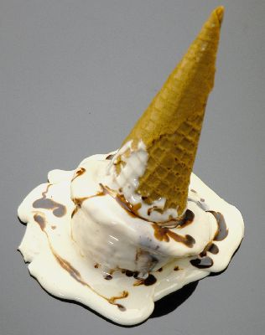
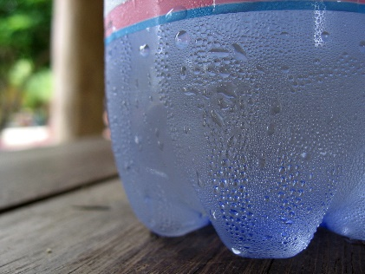
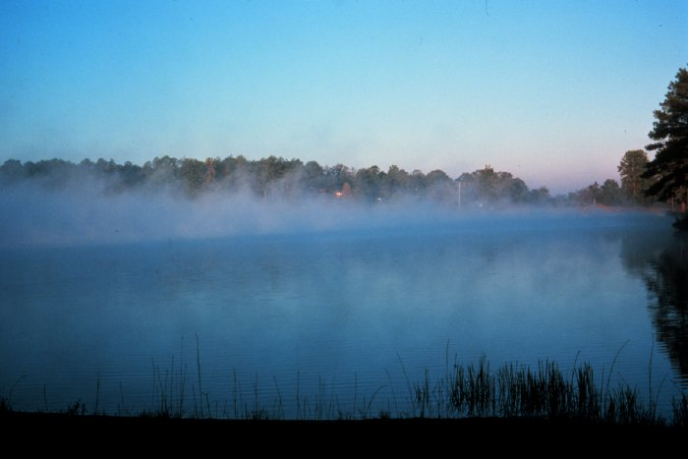
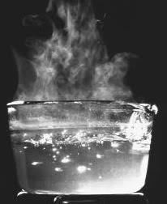
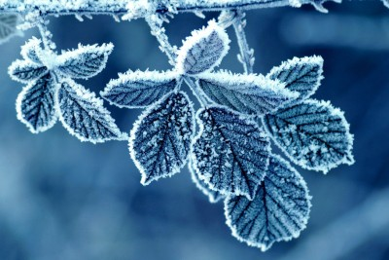
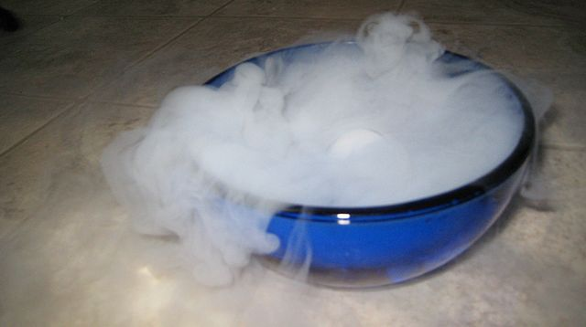
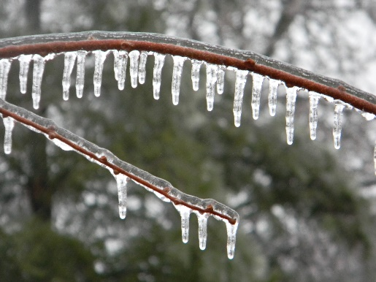
Examples of Phase Changes
Ice cream changing to a liquid
Water on the outside of a cold glass or mirror
Water leaving the top layer of a lake
Boiling water
Frost on leaves
Dry Ice
Water changing to ice

Slide 3
Changes in Matter
Change of State | From a… | To a… | Example
Freezing
Sublimation
Vaporization
Melting
Condensation
Deposition
Liquid
Solid
Ice cream changing to a liquid
Solid
Gas
Dry Ice
Water leaving the top layer of a lake AND boiling water
Liquid
Gas
Solid
Liquid
Ice cream changing to a liquid
Water on the outside of a cold glass or mirror
Gas
Liquid
Gas
Solid
Frost on leaves

Slide 4
Condensation-Cold Surface
Ice cubes

Slide 5
Condensation
A cloud forms when…
cold dust particles collect water vapor in the air.

Slide 6
Condensation
Create a caption for this animation.
As more and more water molecules stick to cold dust particles a cloud gets dark and gray and full of water.
We say the cloud is saturated with water and then it begins to fall apart. We call this precipitation.

Slide 7
What is the opposite of…
condensation
Gas Liquid
Vaporization

Slide 8
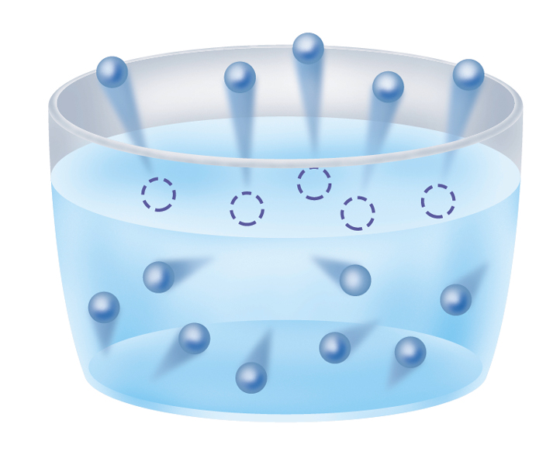
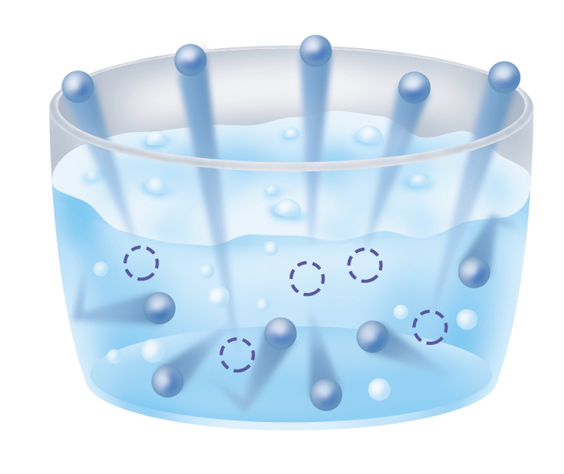


Evaporation
Boiling

Slide 9
Boiling
Hotplate

Slide 10
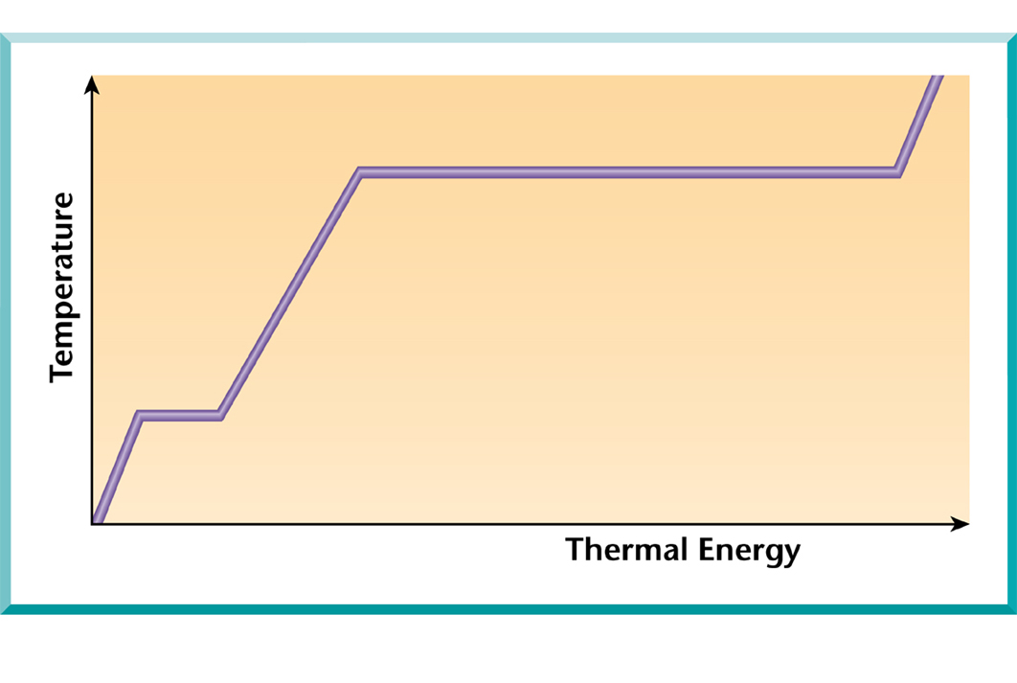
Heating of Water

Slide 11
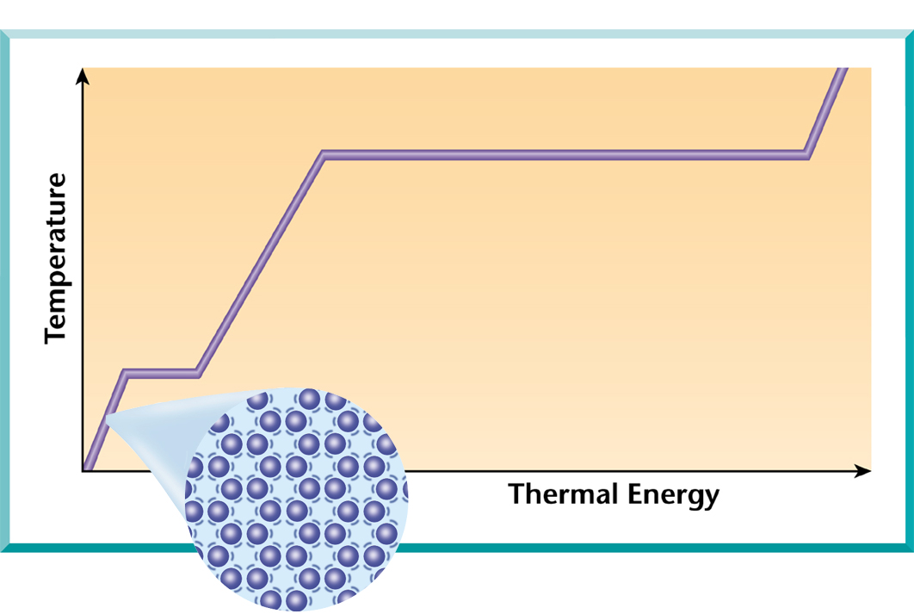
Heating of Water
A. Solid
A.

Slide 12
Heating of Water
A. Solid
B. Melting
B.
A.

Slide 13
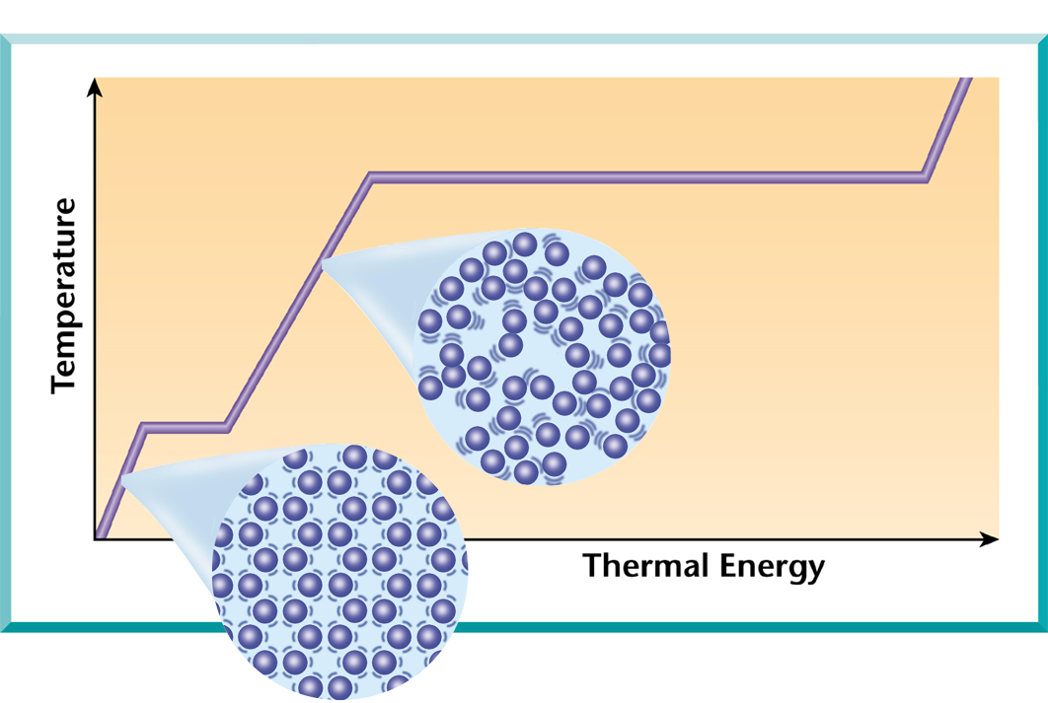
Heating of Water
A. Solid
B. Melting
C. Liquid
C.
B.
A.

Slide 14
Heating of Water
A. Solid
B. Melting
C. Liquid
Vaporization
(Boiling)
D.
C.
B.
A.

Slide 15
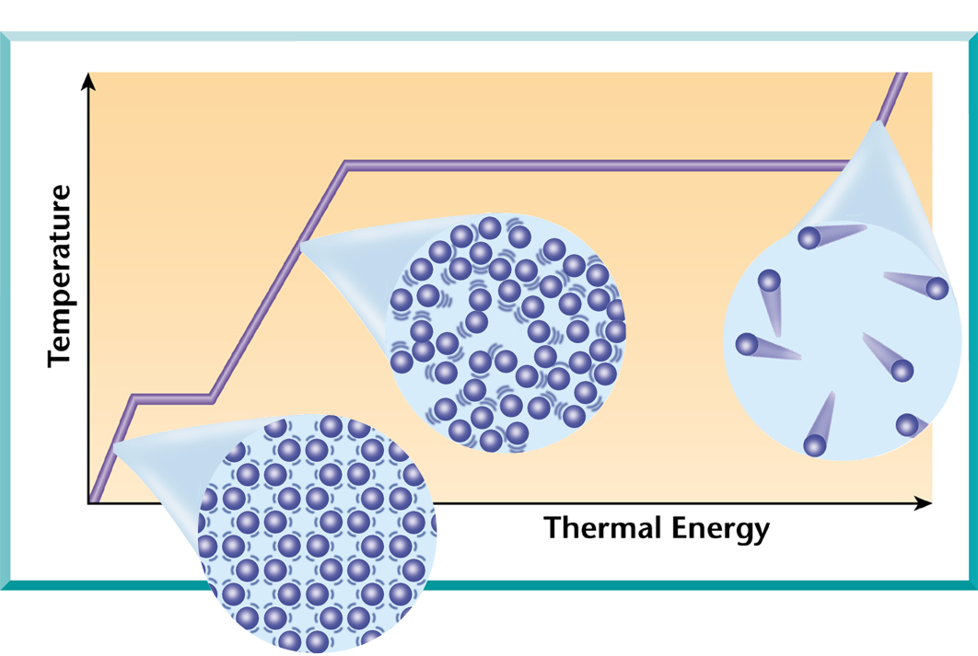
Heating of Water
A. Solid
B. Melting
C. Liquid
Vaporization
(Boiling)
E. Gas
D.
C.
B.
E.
A.

